Slide 1
Advanced Computer Network:
Proxmox VE
Sritrusta Sukaridhoto, Ph.d

Slide 2
Definisi
Proxmox VE is a platform to run virtual machines and containers. It is based on Debian Linux, and completely open source. For maximum flexibility, we implemented two virtualization technologies - Kernel-based Virtual Machine (KVM) and container-based virtualization (LXC).

Slide 3
Central Management
Kelebihan Proxmox antara lain:
  Unique multi-master design
  Proxmox cluster file system (pmxcfs)
  Web based management interface
  Command line
  REST API
  Role-based Administration
  Authentication realm

Slide 4
Flexible Storage
Virtual machine dapat disimpan di storage lokal maupun network shared
Mendukung jenis file system
  LVM Group
  iSCSI target
  NFS share
  Ceph RBD
  GlusterFS

Slide 5
Fitur
Integrated backup & restore
High availability cluster
Flexible networking
  VLAN
Integrated firewall
Open source

Slide 6
Installasi:
HW requirement
CPU: 64bit (Intel EMT64 or AMD64)
Intel VT/AMD-V capable CPU/Mainboard for KVM Full Virtualization support
RAM: 1 GB RAM, plus additional RAM used for guests
Hard drive
One NIC
CPU: 64bit (Intel EMT64 or AMD64), Multi core CPU recommended Proxmox VE Administration Guide 8 / 290
Intel VT/AMD-V capable CPU/Mainboard for KVM Full Virtualization support
RAM: 8 GB RAM, plus additional RAM used for guests
Hardware RAID with batteries protected write cache (“BBU”) or flash based protection
Fast hard drives, best results with 15k rpm SAS, Raid10
At least two NICs, depending on the used storage technology you need more

Slide 7
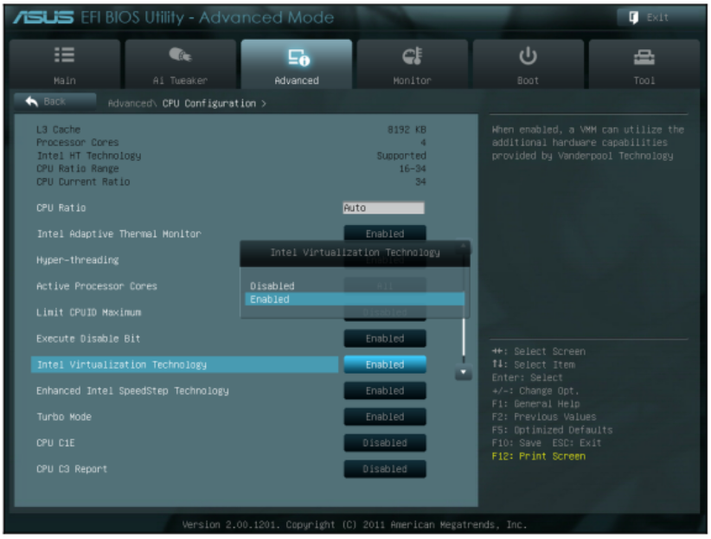
Installasi: persiapan
Download Proxmox VE
  https://www.proxmox.com/en/downloads/category/iso-images-pve
Memastikan hardware virtualization aktif
Boot

Slide 8
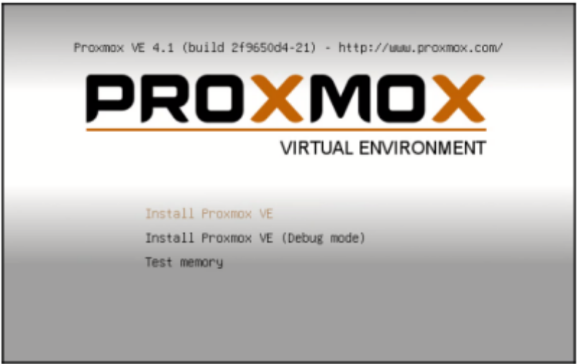
Installasi:
Proses
Installer akan menampilkan menu, dan pilih “Install Proxmox VE”

Slide 9
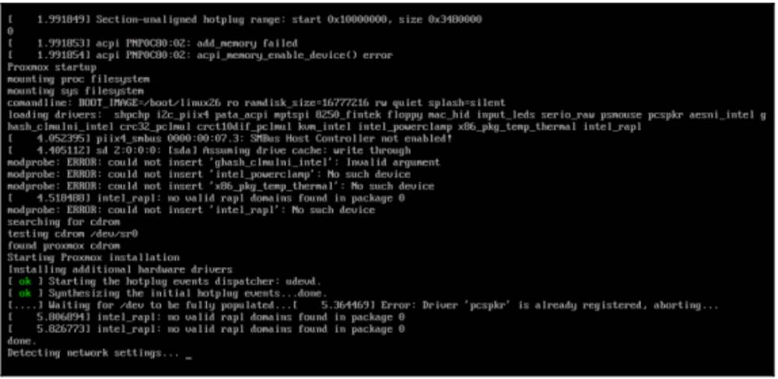
Installasi:
PC boot

Slide 10
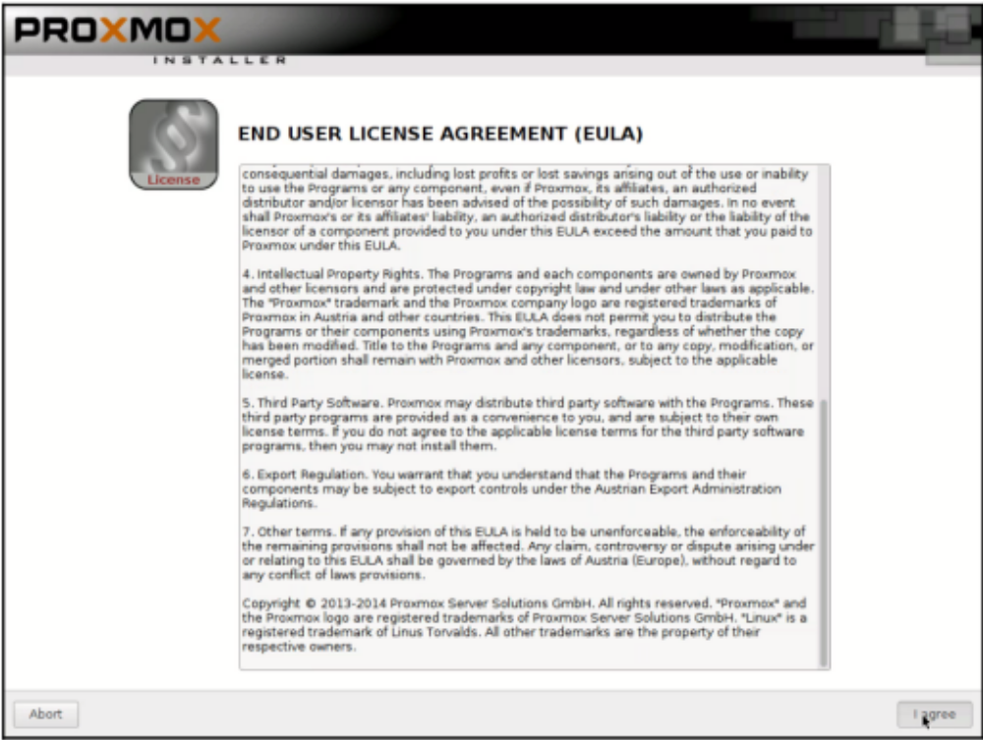
Installasi: end-user license agreement

Slide 11
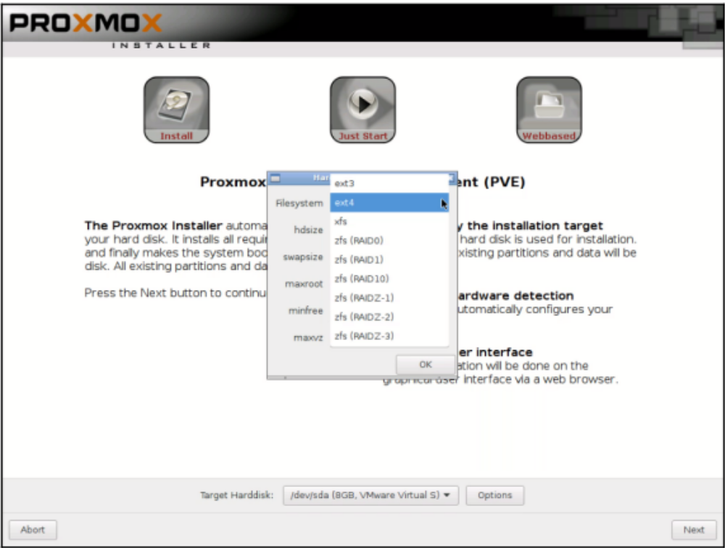
Installasi:
Pemilihan file system
Apabila hanya memiliki 1 drive, pilihan akan dibatasi ext3, ext4, atau xfs

Slide 12
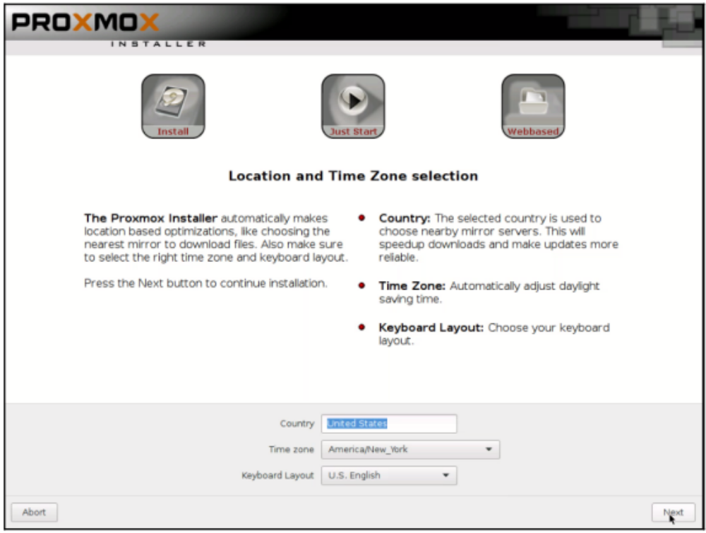
Installasi:
Pemilihan negara, time zone, dan keyboard

Slide 13
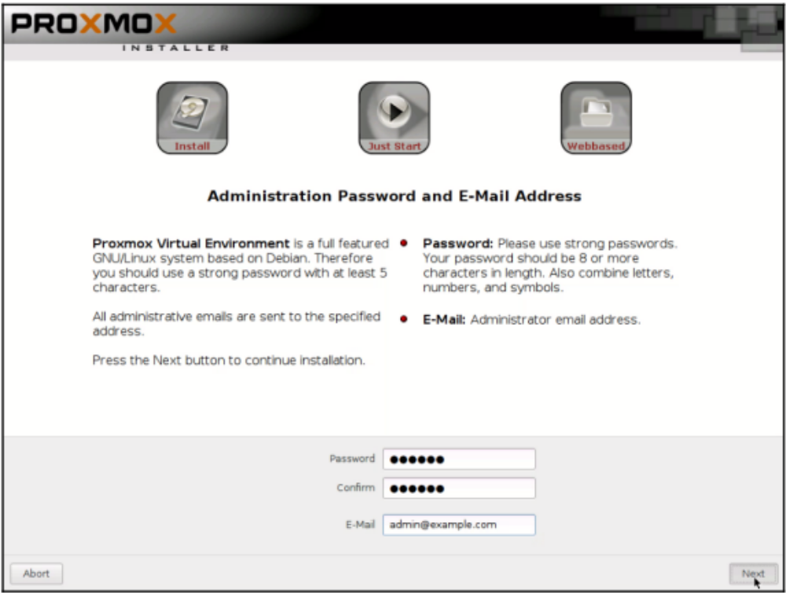
Installasi:
Admin password

Slide 14
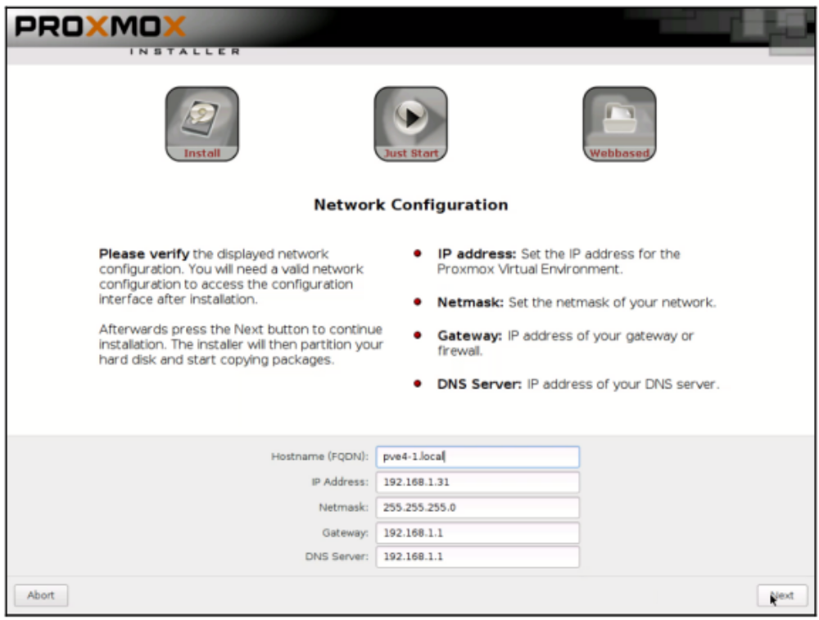
Installasi:
Setting jaringan

Slide 15
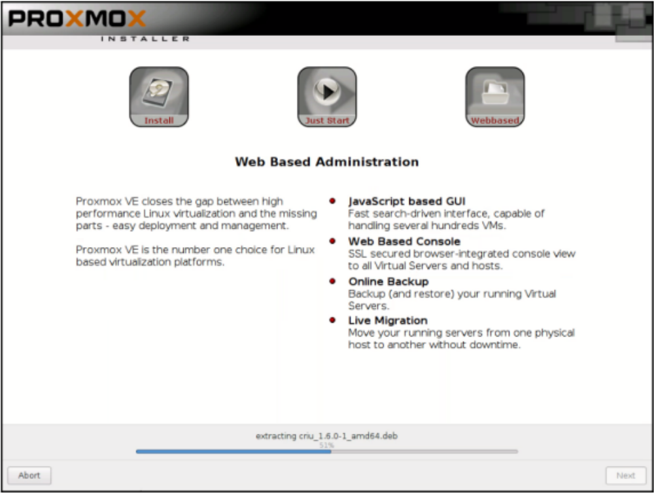
Installasi:
Proses

Slide 16
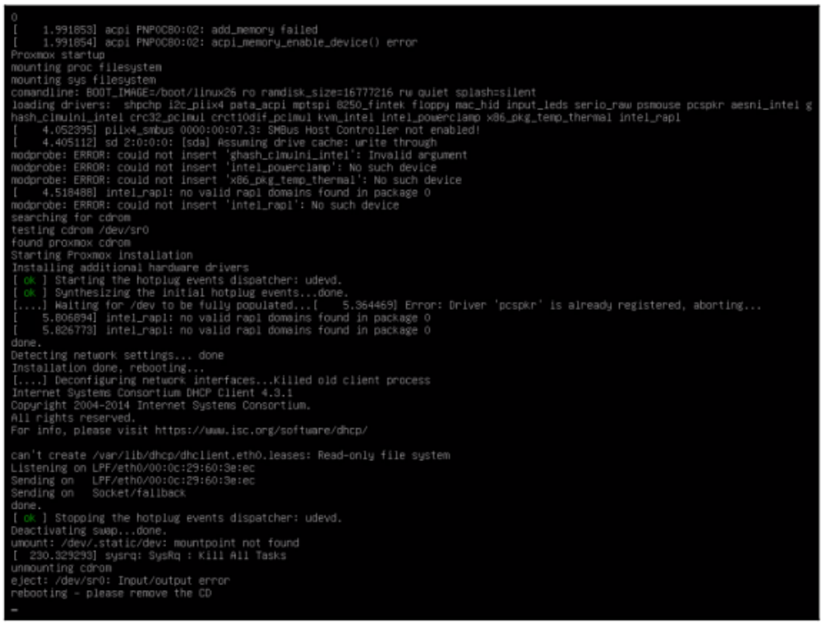
Installasi: reboot

Slide 17
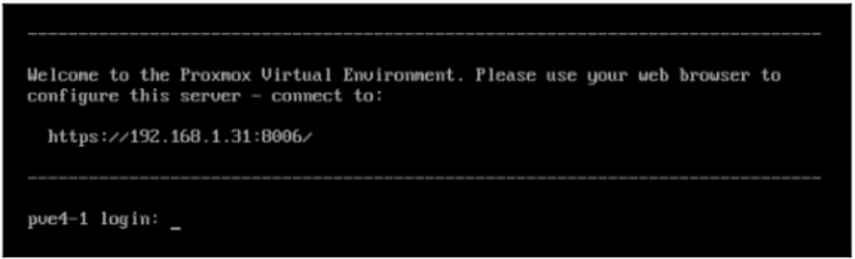
Installasi:
Siap digunakan
Proxmox VE web management dapat diakses di alamat IP dengan port 8006 dan menggunakan protokol HTTPS

Slide 18
Referensi
Goldman, Rik. Learning Proxmox VE. Packt Publishing Ltd, 2016.

