Slide 1
Advanced Computer Network:
Virtualization
SRITRUSTA SUKARIDHOTO, PH.D

Slide 2
Definisi
Wikipedia
  In computing, virtualization refers to the act of creating a virtual (rather than actual) version of something, including virtual computer hardware platforms, storage devices, and computer network resources.

Slide 3
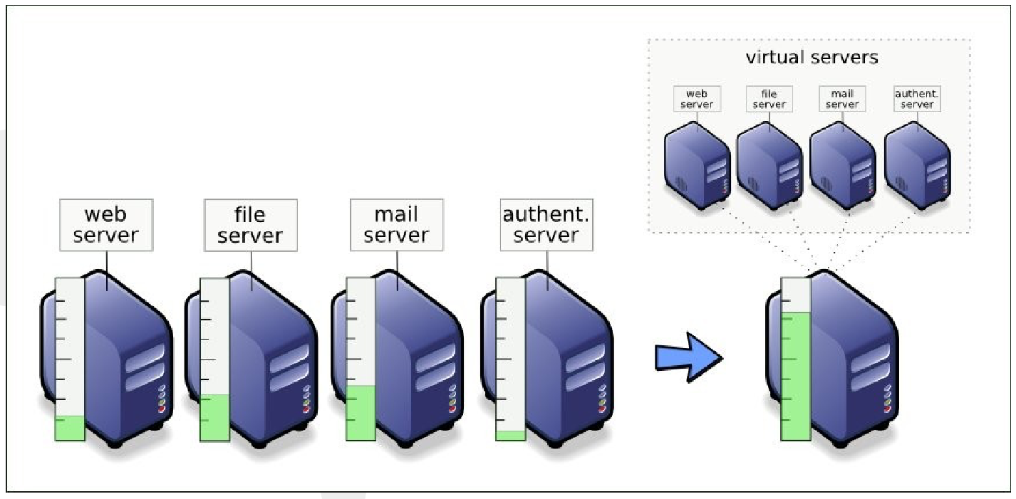
Alasan penggunaan Virtualization (1)

Slide 4
Alasan penggunaan Virtualization (2)
Pengurangan biaya maintenan
Kompatibilitas dengan aplikasi dan OS bawaan
Security: isolasi untuk aplikasi tertentu
Lingkungan pengembangan (dev env) yg murah
Manajemen terpusat
Proses backup yg mudah
Live migration
Quick server fail-over
HA
Virtual Applience
Cloud Computing

Slide 5
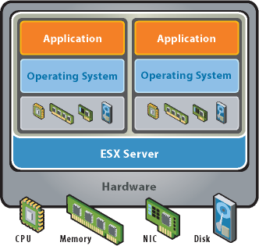
Teknologi utama Virtualization
Partitioning
  Run multiple operating systems on one physical machine
  Divide system resources between virtual machines

Slide 6
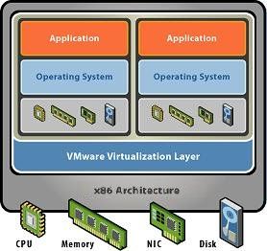
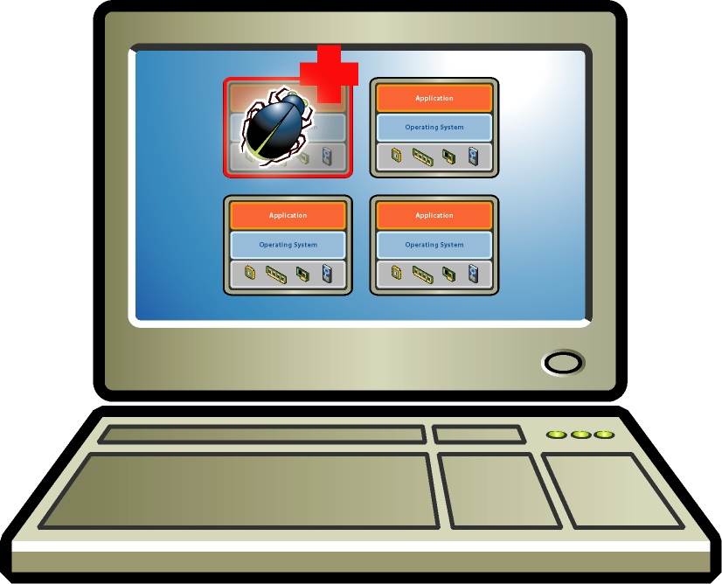
Teknologi utama Virtualization
Partitioning
  Run multiple operating systems on one physical machine
  Divide system resources between virtual machines
Isolation
  Fault and security isolation at the hardware level
  Advanced resource controls preserve performance

Slide 7
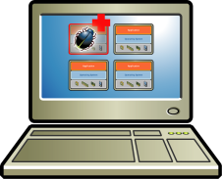
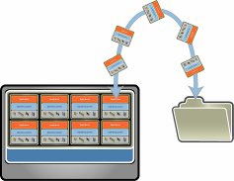
Teknologi utama Virtualization
Partitioning
  Run multiple operating systems on one physical machine
  Divide system resources between virtual machines
Isolation
  Fault and security isolation at the hardware level
  Advanced resource controls preserve performance
Encapsulation
  Entire state of the virtual machine can be saved to files
  Move and copy virtual machines as easily as moving and copying files

Slide 8
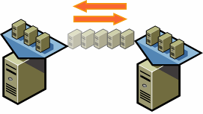
Teknologi utama Virtualization
Partitioning
  Run multiple operating systems on one physical machine
  Divide system resources between virtual machines
Isolation
  Fault and security isolation at the hardware level
  Advanced resource controls preserve performance
Encapsulation
  Entire state of the virtual machine can be saved to files
  Move and copy virtual machines as easily as moving and copying files
Hardware-Independence
  Provision or migrate any virtual machine to any similar or different physical server

Slide 9
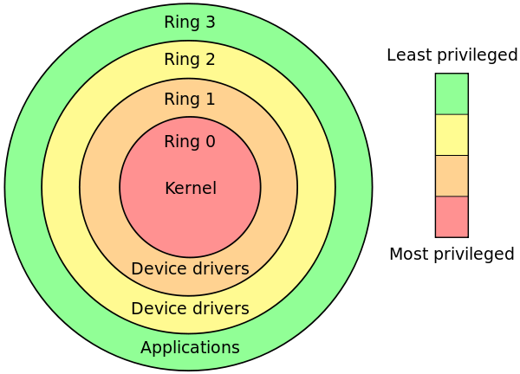
Hypervisor
Terminologi
Sejarah
  1967, 1972, 1987 🡪 IBM mainframe
  2000 🡪 Sun Microsystem, VMware
Protection Ring
  Mekanisme OS untuk melindungi data dari fault dan malicious behaviour
  Menggunakan level privillages
  Mode
    Supervisor / User mode
    Hypervisor

Slide 10
Hypervisor
Terminologi (2)
Hypervisor / Virtual Machine Monitor (VMM)
  Perangkat lunak, firmware atau perangkat keras yang dapat membangun virtual machine.
Jenis mesin (machine)
  Host machine 🡪 komputer yang memiliki hypervisor dan menjalankan virtual machine
  Guest machine / virtual machine (VM) 🡪 komputer virtual yang dijalankan di host machine

Slide 11
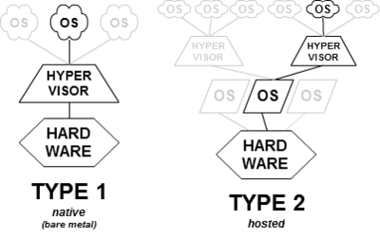
Classification Hypervisor

Slide 12
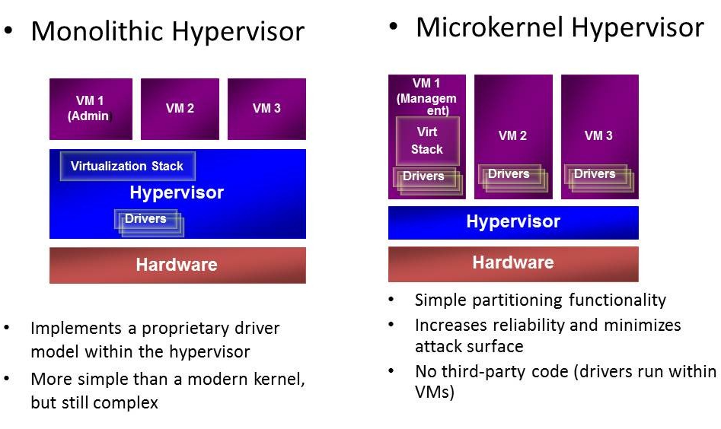
Classification Hypervisor
Type 1

Slide 13
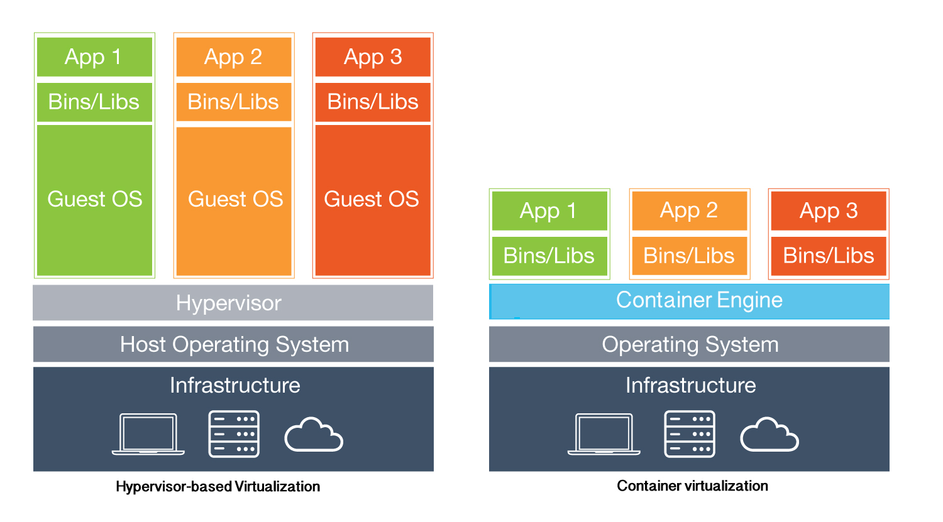
Jenis Virtualization

Slide 14
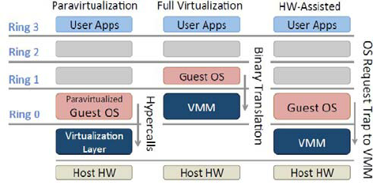
Teknologi Virtualization berbasis Hypervisor

Slide 15
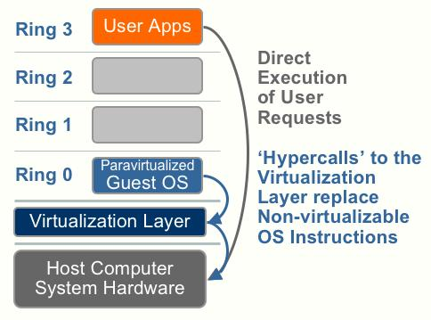
Teknologi Virtualization
OS assisted virtualization / paravirtualization
Teknik yg ringan
Hypervisor memberikan API dan digunakan guest machine dengan memodifikasi OS
Tidak memerlukan virtualization extension dari host machine

Slide 16
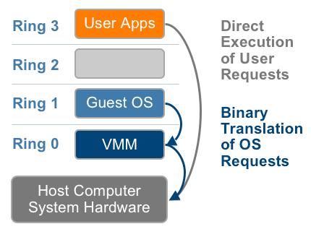
Teknologi Virtualization
Full Virtualization
Di handle oleh VMM
Guest machine seamless
Tidak memerlukan modifikasi perangkat keras

Slide 17
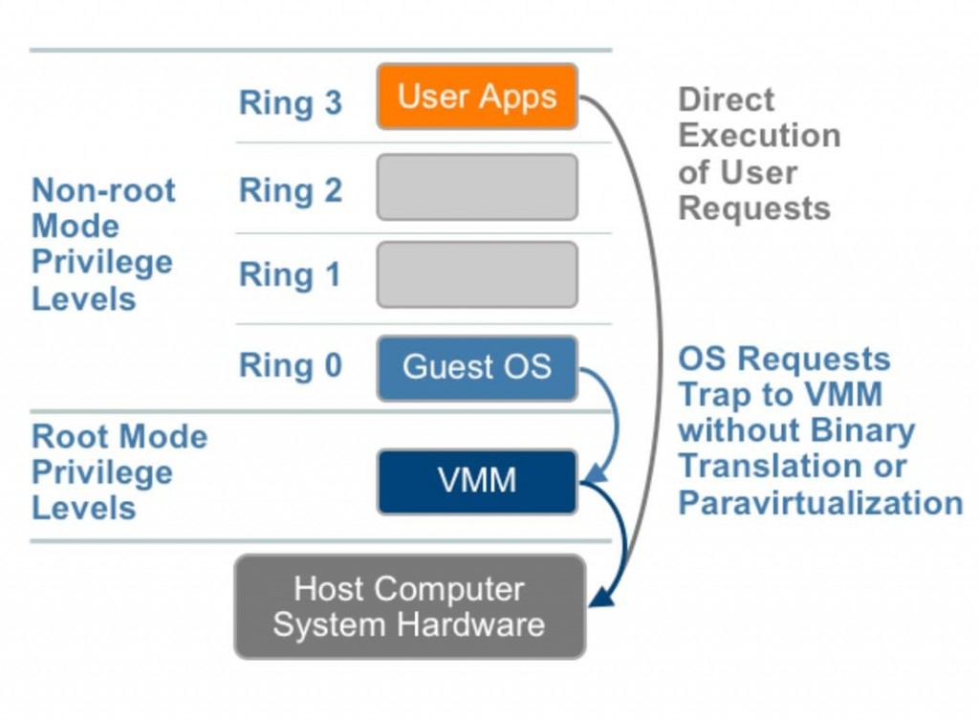
Teknologi Virtualization
Hardware Assisted Virtualization
Full virtualization yang didukung perangkat keras
Guest OS tidak perlu dimodifikasi
Hypervysor melakukan trap
Contoh:
  Intel VT-x
  AMD-V

Slide 18
Teknologi Virtualization
Perbandingan
 | PARA VIRTUALIZATION | FULL VIRTUALIZATION | HARDWARE ASSISTED
Teknik | Hypercall | Direct Execution | Exit to root mode on privileged instruction
Guest OS modifikasi | Guest OS dimodifikasi untuk dapat menjalankan hypercall | Tidak dimodifikasi | Tidak dimodifikasi
Performasi | Lebih baik di beberapa kasus | baik | cukup
Contoh | VMware, xen | VMware, Microsoft, KVM | VMware, xen, microsoft, parallel
Ketergantungan hypersor pada Guest OS | XenLinux hanya jalan di hypersor xen | ya | ya

Slide 19
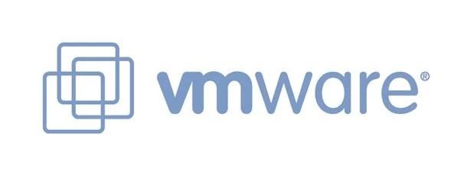
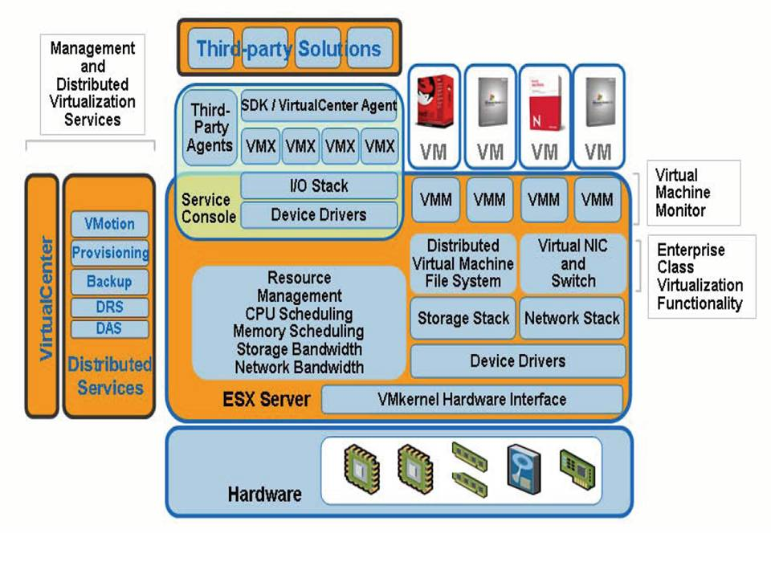

Slide 20

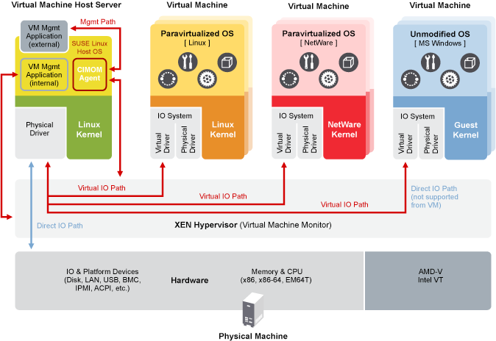

Slide 21
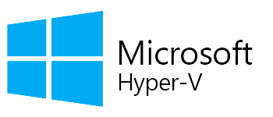
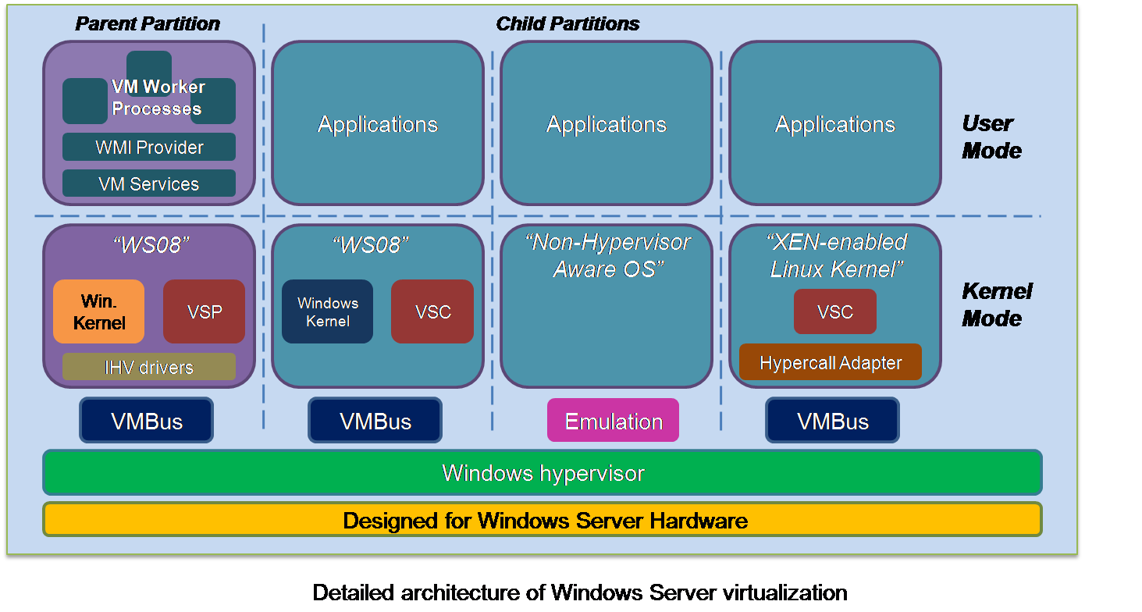

Slide 22
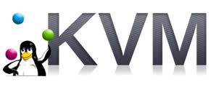
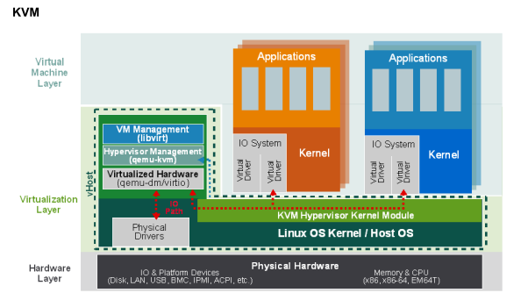

Slide 23
Penggunaan
Virtual Private Server (VPS)
  Amazon Elastic Compute Cloud (EC2)
    Xen
  Microsoft Azure
    Microsoft Hyper-V
  Google Compute Engine (GCE)
    KVM
  Rackspace
    VMware

Slide 24
Teknologi Virtualization berbasis Container
Operating-system-level virtualization / Containerization
  Fitur sistem operasi yang mampu membuat isolasi user-space di host machine.
  Contoh
    Linux Container
    Docker

Slide 25
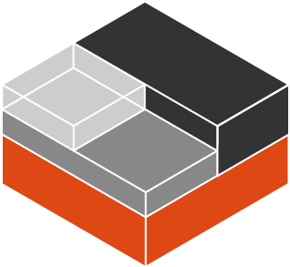
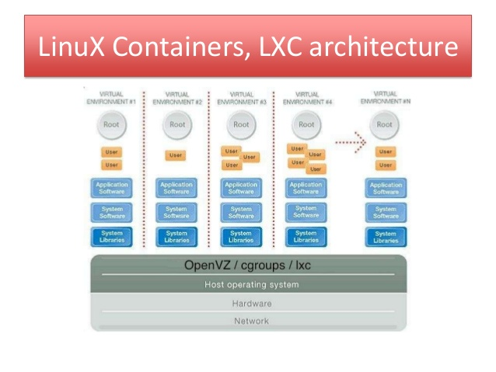

Slide 26

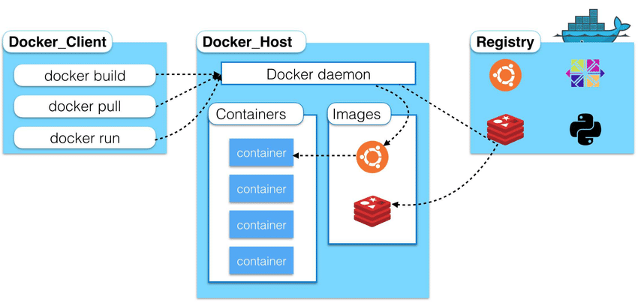

Slide 27
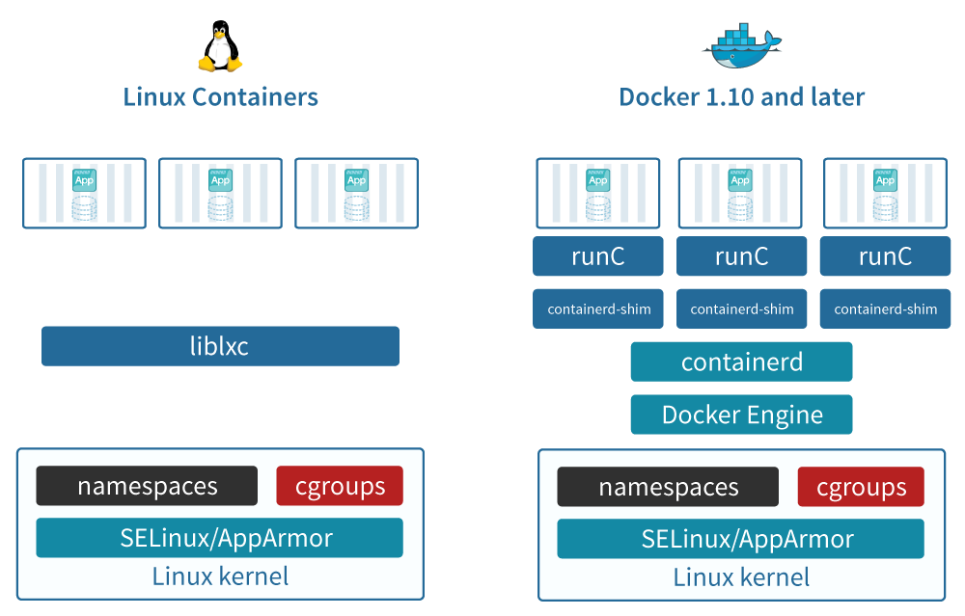
Teknologi Virtualization berbasis Container - Perbandingan

Slide 28
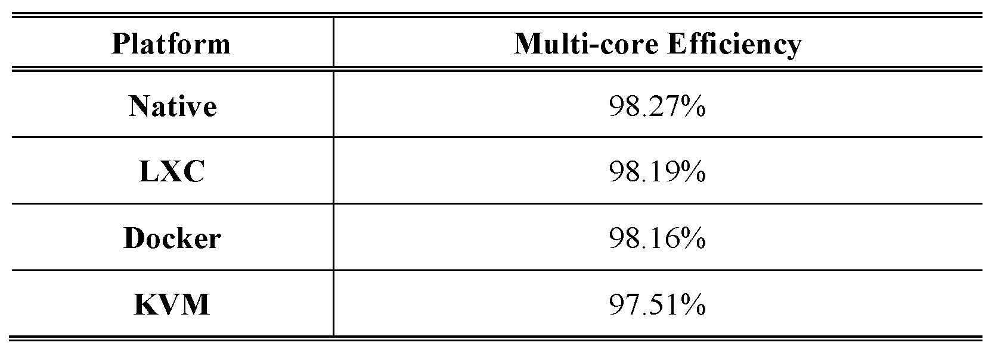
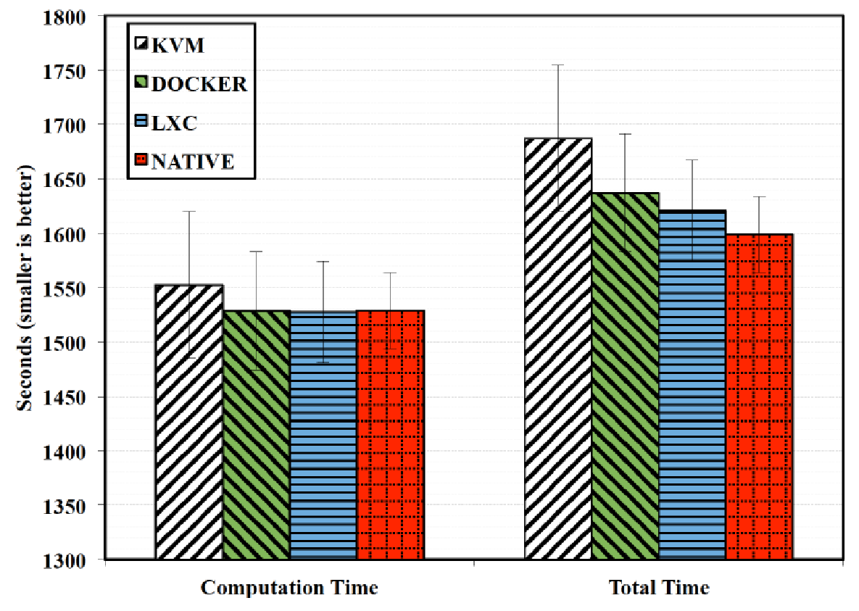
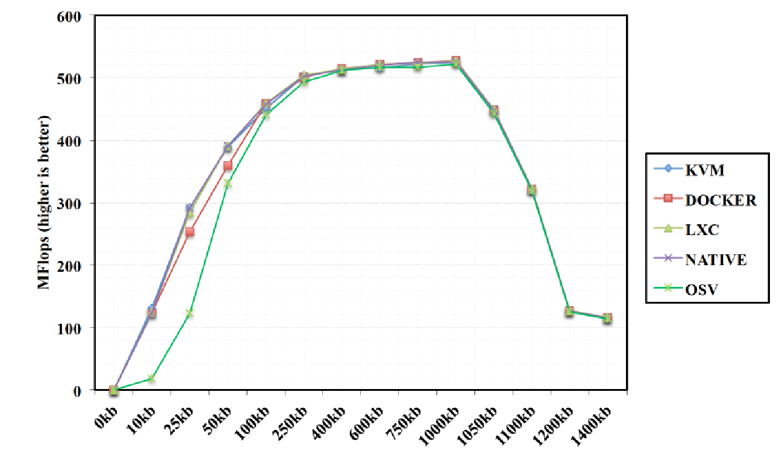
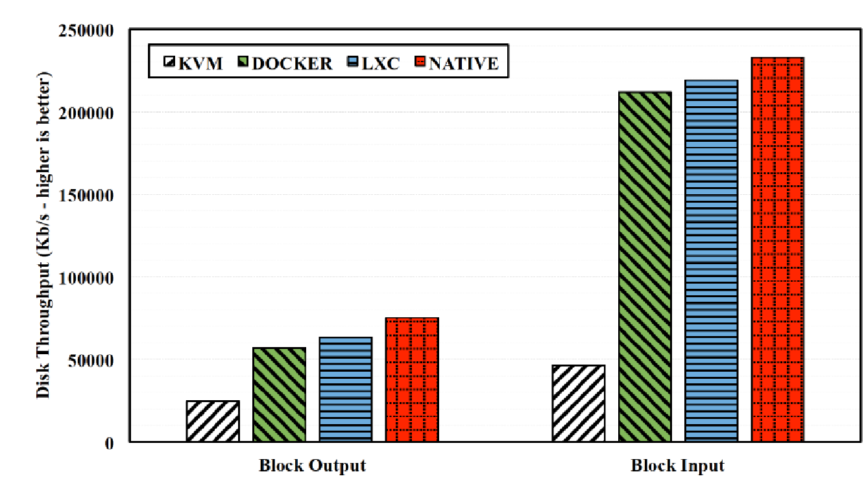
Performasi

Slide 29
Referensi
https://en.wikipedia.org/wiki/Hypervisor
https://en.wikipedia.org/wiki/Hardware_virtualization
https://en.wikipedia.org/wiki/Operating-system-level_virtualization
Morabito, Roberto, Jimmy Kjällman, and Miika Komu. "Hypervisors vs. lightweight virtualization: a performance comparison." Cloud Engineering (IC2E), 2015 IEEE International Conference on. IEEE, 2015.

