Slide 1
Advanced Computer Network:
Container
Sritrusta sukaridhoto

Slide 2
Container
Definisi menurut wikipedia
  Operating-system-level virtualization, also known as containerization, refers to an operating system feature in which the kernel allows the existence of multiple isolated user-space instances. Such instances, called containers,^{[1]} partitions, virtualization engines (VEs) or jails (FreeBSD jail or chroot jail), may look like real computers from the point of view of programs running in them. A computer program running on an ordinary person's computer's operating system can see all resources (connected devices, files and folders, network shares, CPU power, quantifiable hardware capabilities) of that computer. However, programs running inside a container can only see the container's contents and devices assigned to the container.

Slide 3
Software Container
Contoh:
  Chroot
  Docker
  OpenVZ
  LXC
  FreeBSD Jail

Slide 4
LXC
LXC (Linux Containers) is an operating-system-level virtualization method for running multiple isolated Linux systems (containers) on a control host using a single Linux kernel.
Pembuatan container dengan GUI dan Proxmox Container Toolkit (PCT)

Slide 5
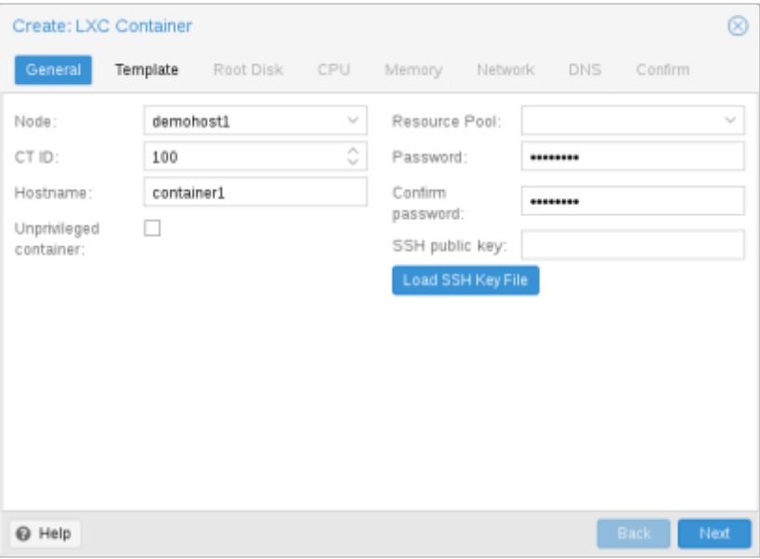
Pembuatan Container:
General settings
Node: pemilihan server fisik
CT ID: identifikasi nomer container
Hostname: penamaan container
Resource Pool: pengelompokan container
Password: password dasar untuk container
SSH Public Key: ssh key
Unprivileged container:
  Privileged → digunakan di trusted network
  Unprivileged → public

Slide 6
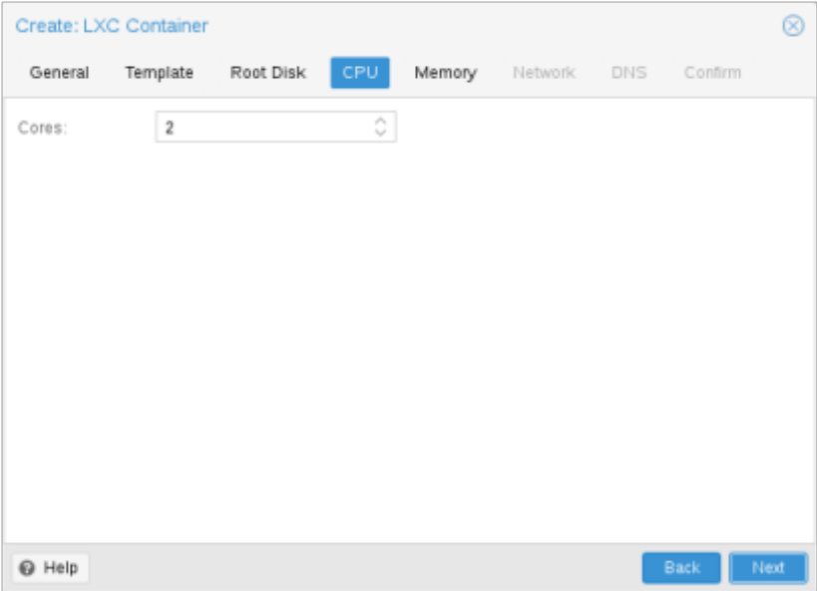
Pembuatan Container:
CPU
Cores: penggunaan jumlah core pada container

Slide 7
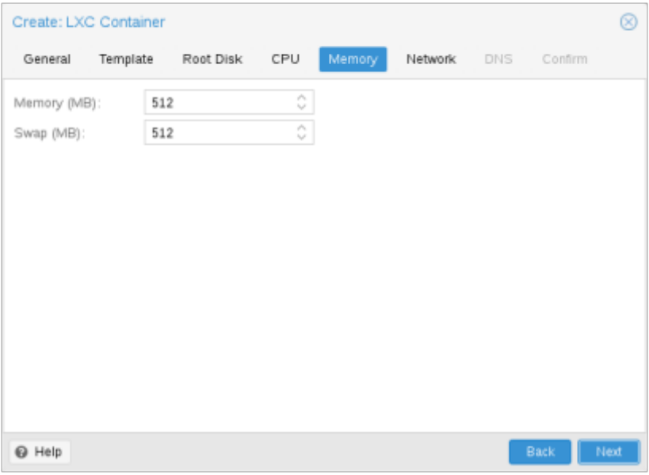
Pembuatan Container:
Memory
Memory: jumlah penggunaan memory pada container
SWAP: jumlah penggunaan swap pada container

Slide 8
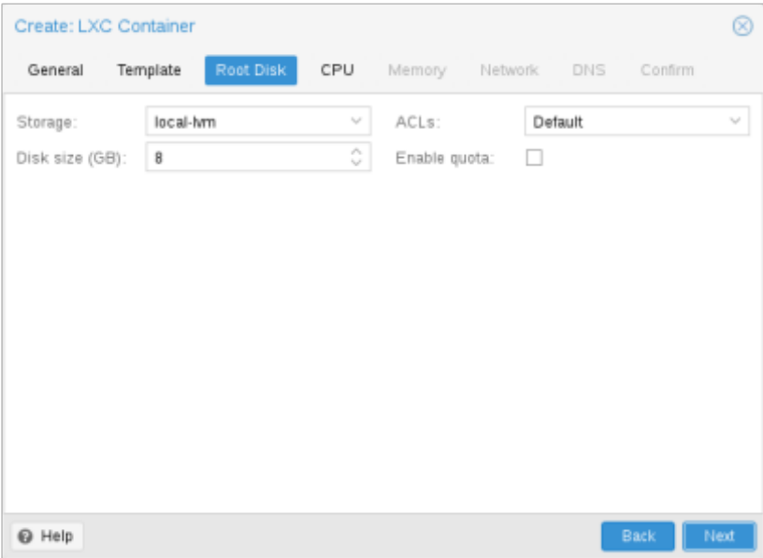
Pembuatan Container:
Mount-Point
Penggunaan hard-disk pada server fisik

Slide 9
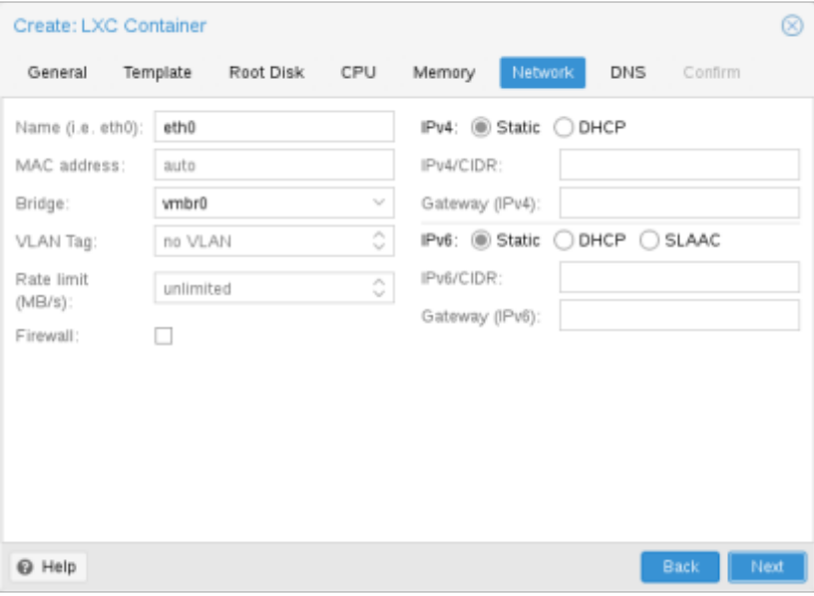
Pembuatan Container:
Network
Name: pemilihan interface jaringan pada container
Bridge: penghubung jaringan pada server fisik
IPv4 dan IPv6
  Penggunaan static dan dhcp

Slide 10
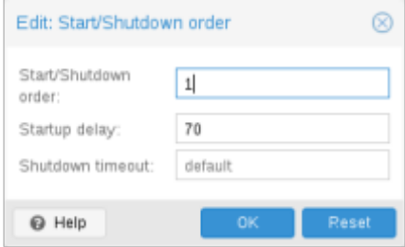
Pembuatan Container:
Start & Shutdown
Pengaturan urutan start dan shutdown container

Slide 11
Pengaturan Container dengan PCT(1)
Pembuatan
  pct create 100 /var/lib/vz/template/cache/debian-8.0-standard_8.0-1 _amd64.tar.gz
Start
  pct start 100
Masuk ke console getty
  pct console 100
Masuk ke root
  pct enter 100

Slide 12
Pengaturan Container dengan PCT(2)
Melihat konfigurasi
  pct config 100
Pengaturan jaringan
  pct set 100 -net0 name=eth0,bridge=vmbr0,ip=192.168.15.147/24,gw ← =192.168.15.1
Pengaturan memory
  pct set 100 -memory 512

Slide 13
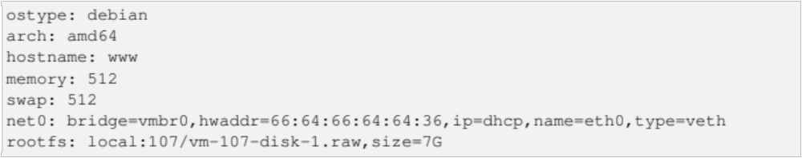
Konfigurasi Container
File konfigurasi terletak di
  /etc/pve/lxc/<CTID>.conf
    Dimana <CTID> adalah nomer container

Slide 14
Penguncian (lock)
Container akan dikunci (lock) melalui software pada saat proses migrasi, apabila terjadi suatu hal perlu dilakukan pembukaan kunci (unlock) pada container dengan cara:
  pct unlock <CTID>

