Slide 1
Advanced Computer Networks:
Pengenalan Cloud Computing
Sritrusta Sukaridhoto, Ph.D

Slide 2
Hype Cycle of ICT
DevOps
Community Cloud
OpenStack
PaaS
Big Data
IaaS
SaaS
CLOUD
COMPUTING

Slide 3
Definisi
According to Prof. Raj Kumar Buyya – Univ. of Melbourne, Australia:
  “A Cloud is a type of parallel and distributed system consisting of a collection of interconnected and virtualized computers that are dynamically provisioned and presented as one or more unified computing resources based on service-level agreements established through negotiation between the service provider and consumers.”
Wikipedia
  Cloud computing is an information technology (IT) paradigm, a model for enabling ubiquitous access to shared pools of configurable resources (such as computer networks, servers, storage, applications and services), which can be rapidly provisioned with minimal management effort, often over the Internet. Cloud computing allows users and enterprises with various computing capabilities to store and process data either in a privately-owned cloud, or on a third-party server located in a data center - thus making data-accessing mechanisms more efficient and reliable. Cloud computing relies on sharing of resources to achieve coherence and economy of scale, similar to a utility.

Slide 4
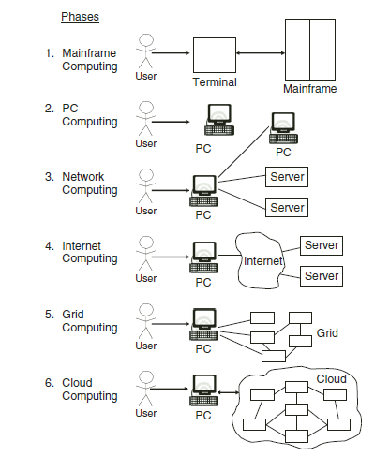

Slide 5
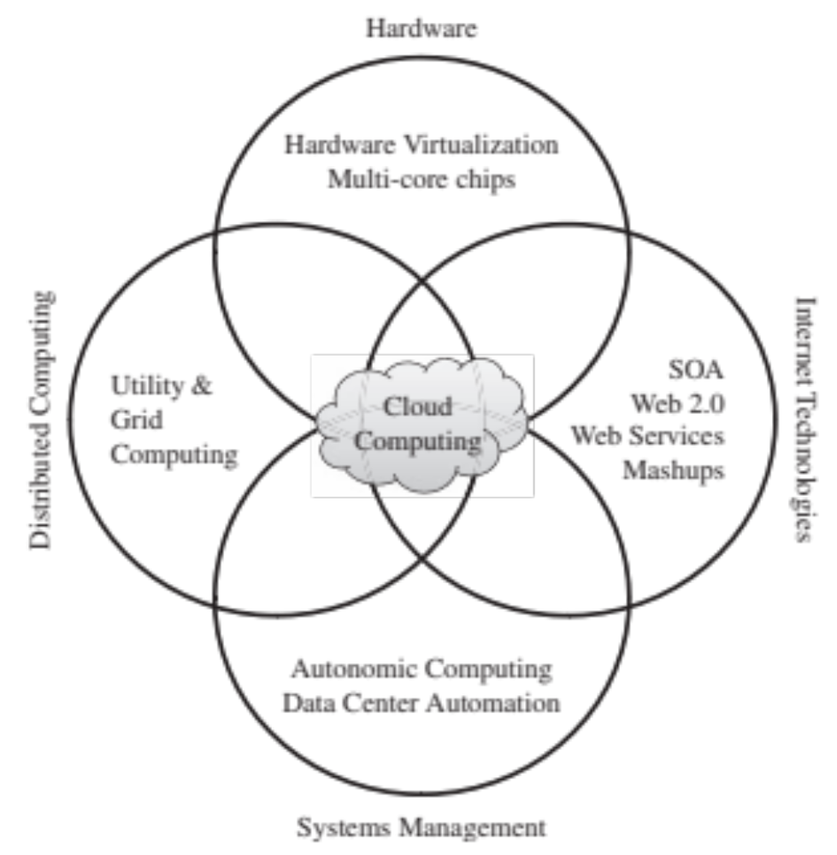
Teknologi dibalik Cloud Computing
Teknologi Internet
Distributed Computing
Perangkat Keras
Sistem manajemen

Slide 6
Teknologi dibalik Cloud Computing
SOA, Web Services, Web 2.0, dan kombinasinya
Perkembangan web services (WS) yang semakin popular, dan terstandarisasi
  HTTP dan XML
  Terbentuknya Service-Oriented Application (SOA)
Standarisasi →Web 2.0

Slide 7
Teknologi dibalik Cloud Computing
Grid & Utility Computing

Slide 8
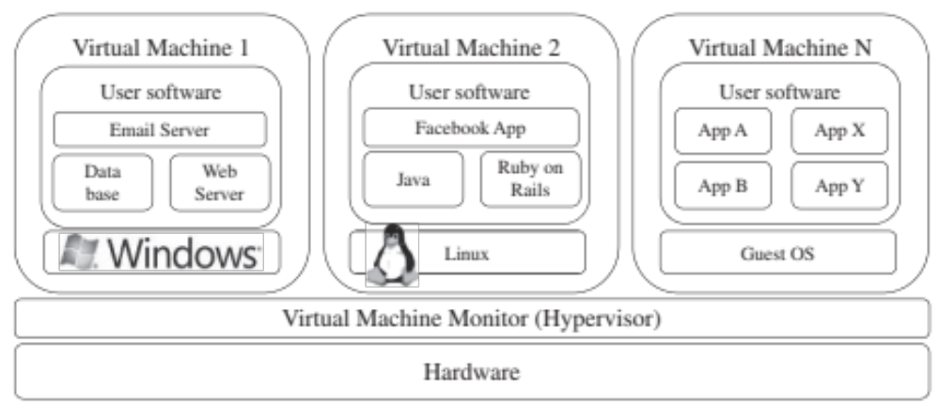
Teknologi dibalik Cloud Computing
Virtualization

Slide 9
Teknologi dibalik Cloud Computing
Autonomic Computing
Wikipedia
  Autonomic computing (also known as AC) refers to the self-managing characteristics of distributed computing resources, adapting to unpredictable changes while hiding intrinsic complexity to operators and users.

Slide 10
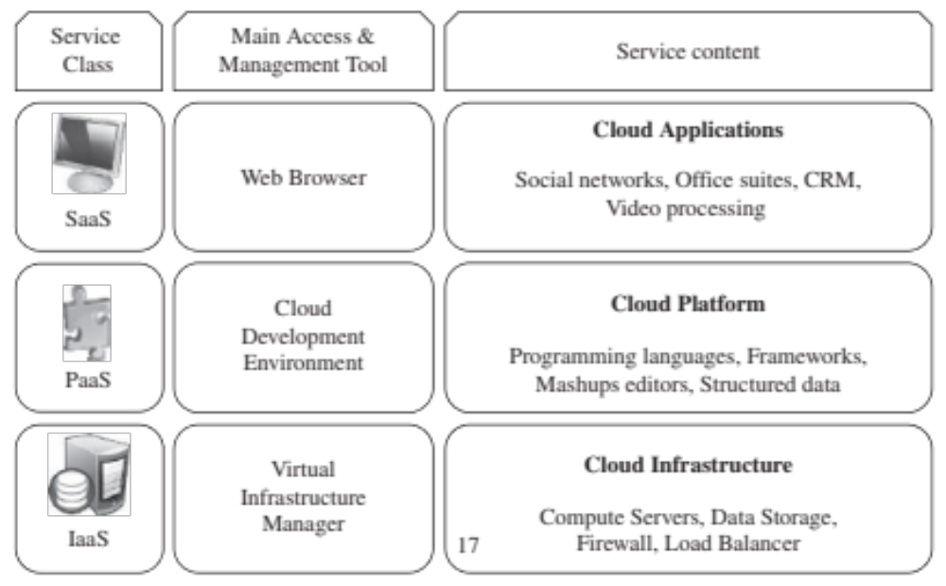
Tipe Cloud Computing

Slide 11
Tipe Cloud Computing
Infrastructure as a Service (IaaS)
Memberikan pelayanan sumber daya virtual (komputasi, penyimpanan, dan komunikasi) → Infrastructure as a Service (IaaS)
Cloud Infrastructure
  Server
  Storage
  Firewall
  Load Balancer
Contoh:
  Amazon Web Services → Amazon EC2

Slide 12
Tipe Cloud Computing
Platform as a Service (PaaS)
Cloud yang memberikan pelayanan kepada user tanpa harus memperhatikan infrastruktur → Platform as a Service (PaaS)
Cloud Platform
  Programming language
  Framework
  Data terstruktur
Contoh:
  Google AppEngine

Slide 13
Tipe Cloud Computing
Software as a Service (SaaS)
Software yang digunakan melalui cloud, tanpa harus di pasang di komputer cient. Tipe cloud ini disebut → Software as a Service (SaaS)
Contoh:
  Salesform.com
  Bukalapak.com
  Microsoft Office 360

Slide 14
Model Cloud Computing berdasarkan Lokasi Pembentukan

Slide 15
Fitur Cloud
Self-service
  Cloud yang bisa di modifikasi tanpa bantuan operator
Per-Usage Metering dan Billing
  Jenis pembayaran per-penggunaan tidak model sewa keseluruhan, sehingga apabila tidak terpakai tidak perlu membayar
Elasticity
  Dapat dengan mudah ditambahkan atau dikurangkan apabila membutuhkan sumber daya lainnya
Customization
  Mudah untuk dimodifikasi

Slide 16
Referensi
Buyya, Rajkumar, James Broberg, and Andrzej M. Goscinski, eds. Cloud computing: Principles and paradigms. Vol. 87. John Wiley & Sons, 2010.

